Slide 1
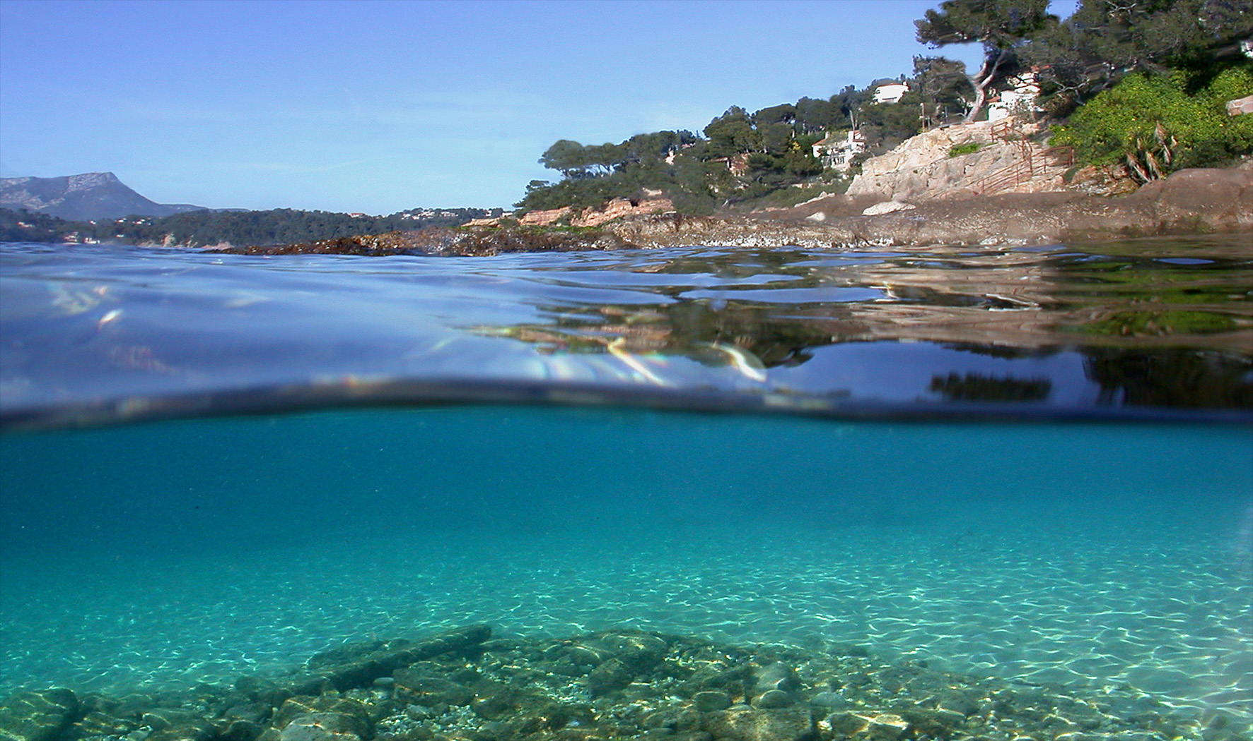
Garonne Beach

Slide 2
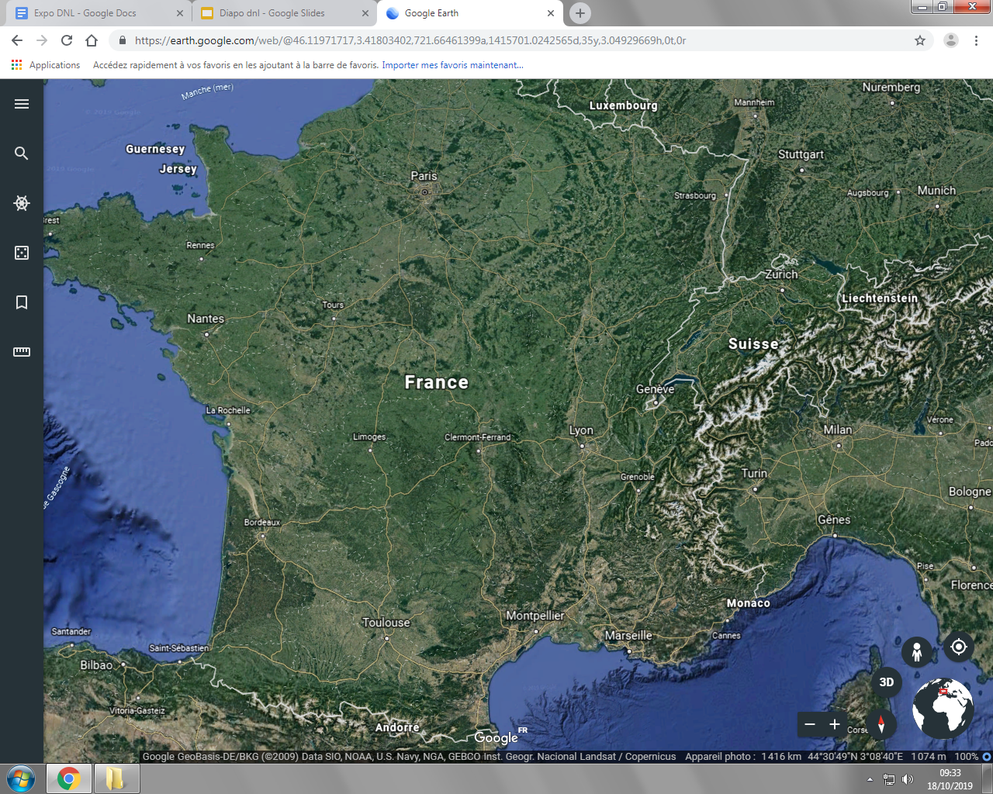


Slide 3
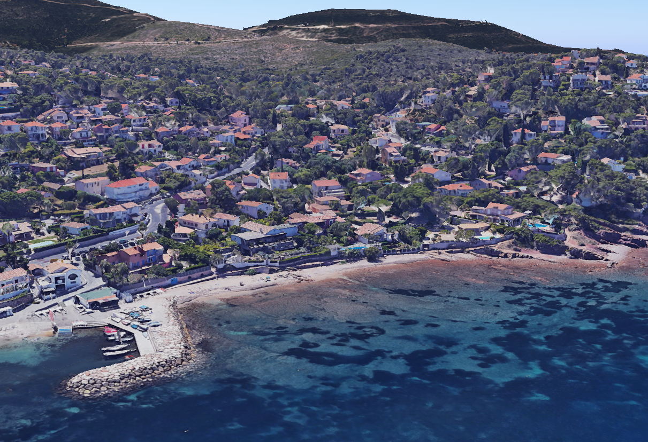
Garonne beach
43°05’26”N 6°01’26”E

Slide 4
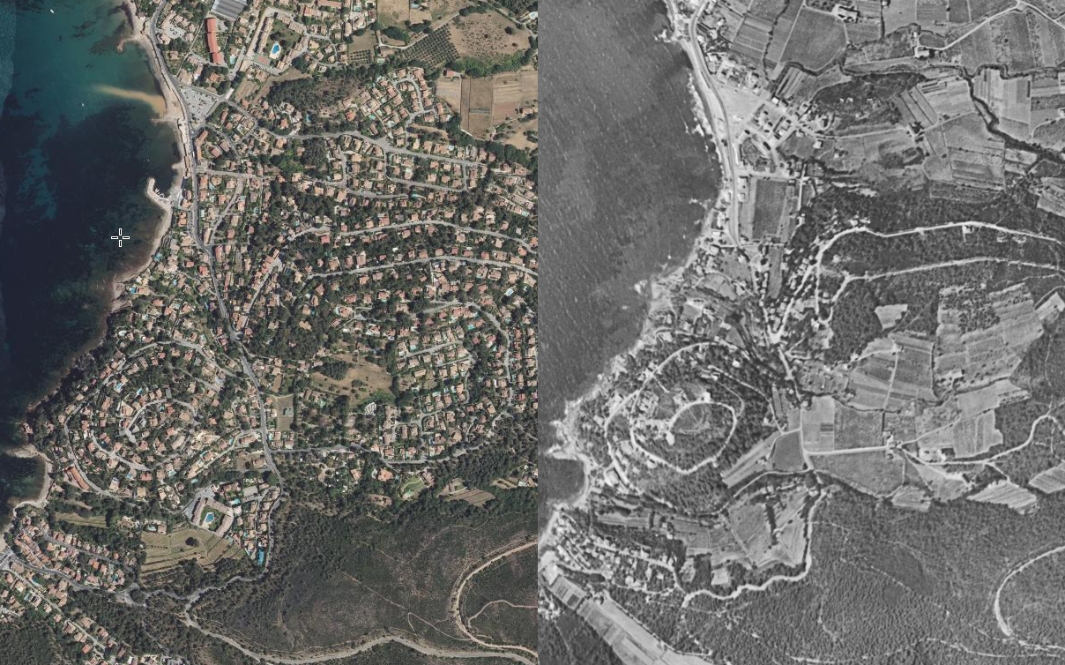
2017
1950

Slide 5
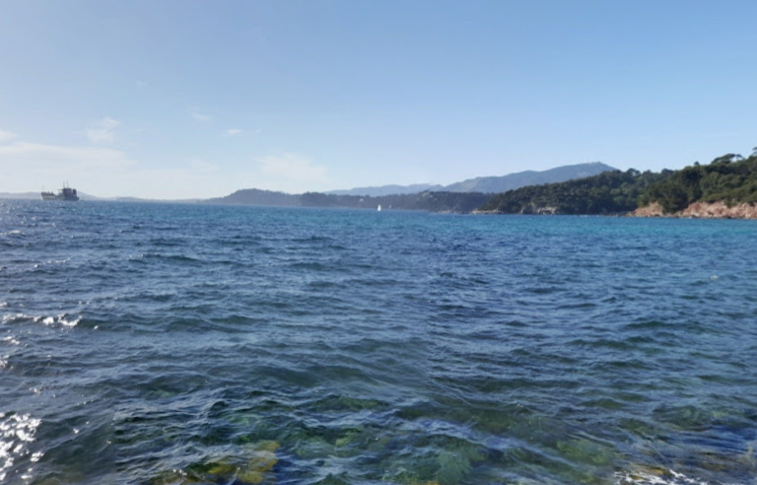
hill of six-fours
Mont Caume
Le Faron

Slide 6
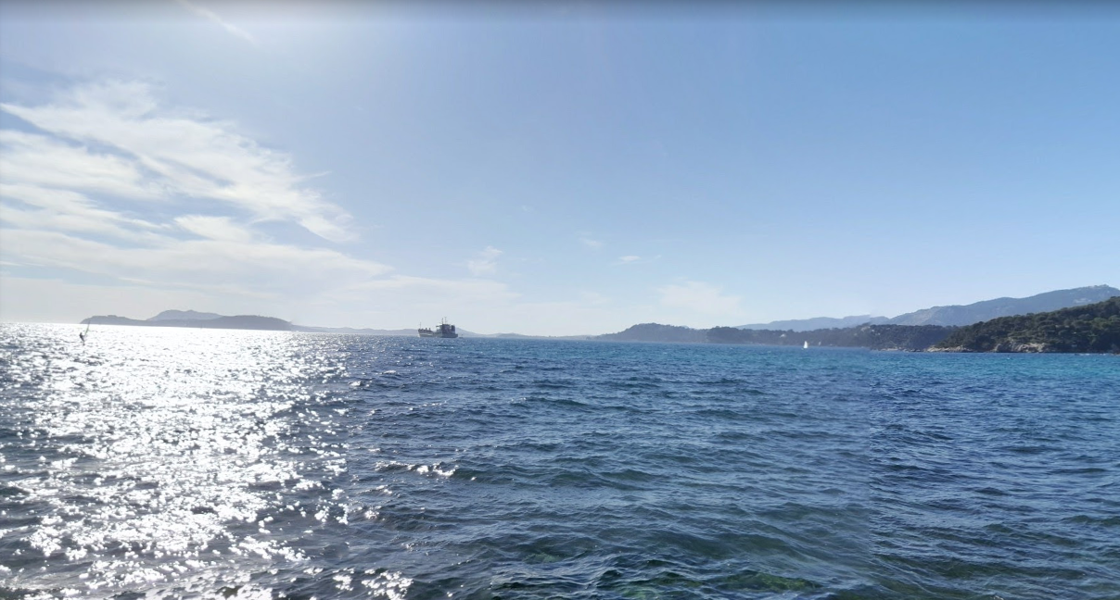
Seyne-sur-Mer
St Mandrier
Toulon
La Garde

Slide 7
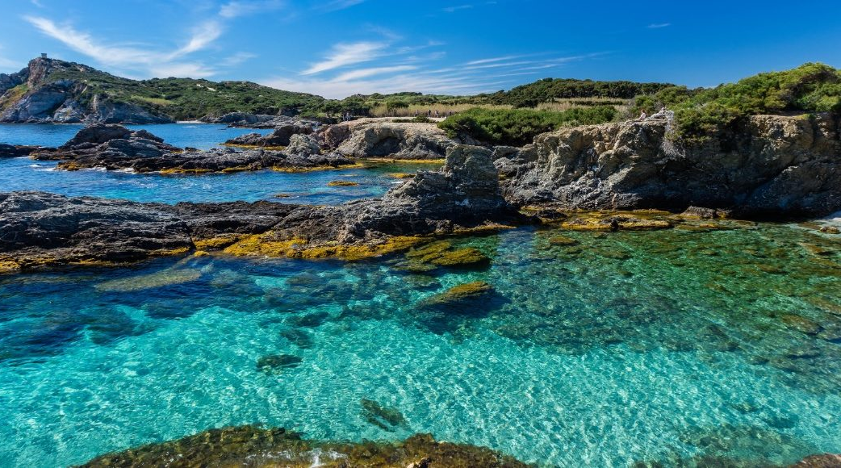
The mediterranean characteristics
SCUBA DIVING & WASTE PICKING
2019
TEINTURIER Emma, CADIOU Amandine, THOMASSIN Lalie
2nd 9, 13

Slide 8
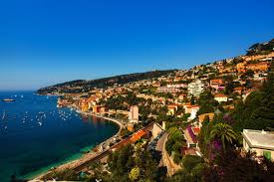
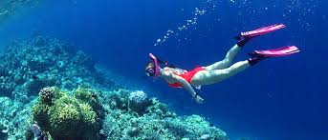
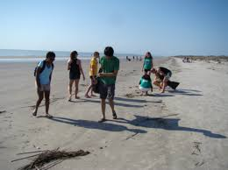
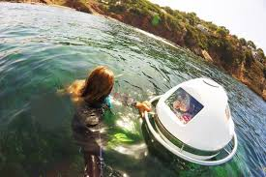
OUTING OF THE 27th SEPTEMBER
23 degrees
We went scuba diving and waste tripping.
23.6 degrees

Slide 9





Mediterranean climate characteristics :
average temperature above 22°C near the sea, temperature can often exceed 30°C on the continents and usually go up to 40th °C
but always never under -10average temperature above 5°C temperature can often go down °C
Summer climate
Fall climate
Winter climate
Spring climate
Lack of water ?
Drought and hot
temperatures
important rainfalls.
dought and cool temperatures.
important rainfalls.
.
spring and autumns very wet, often in the form of thunderstorms (40% of the annual total in 3 months) rain>100 days per years

Slide 10
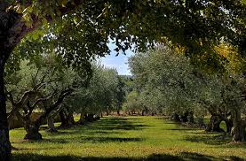



The Mediterranean area in France
The area
the climate is preserved
Vegetable marker
South East of France and on all the French coast.
by the mountains that surround the area.
olive tree

Slide 11

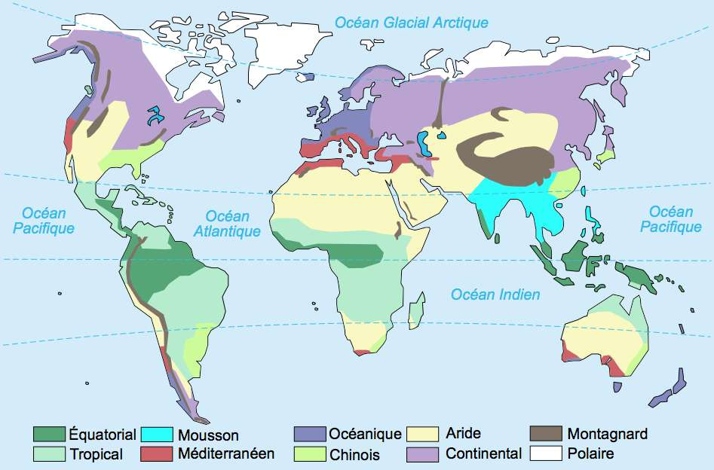



The Mediterranean area in the world
around the mediterranean sea
obviously
in the south
on the west facades of continents, between 30 and 40 degrees of latitude:
in the north
for example, California or the Cape region in South Africa.

Slide 12
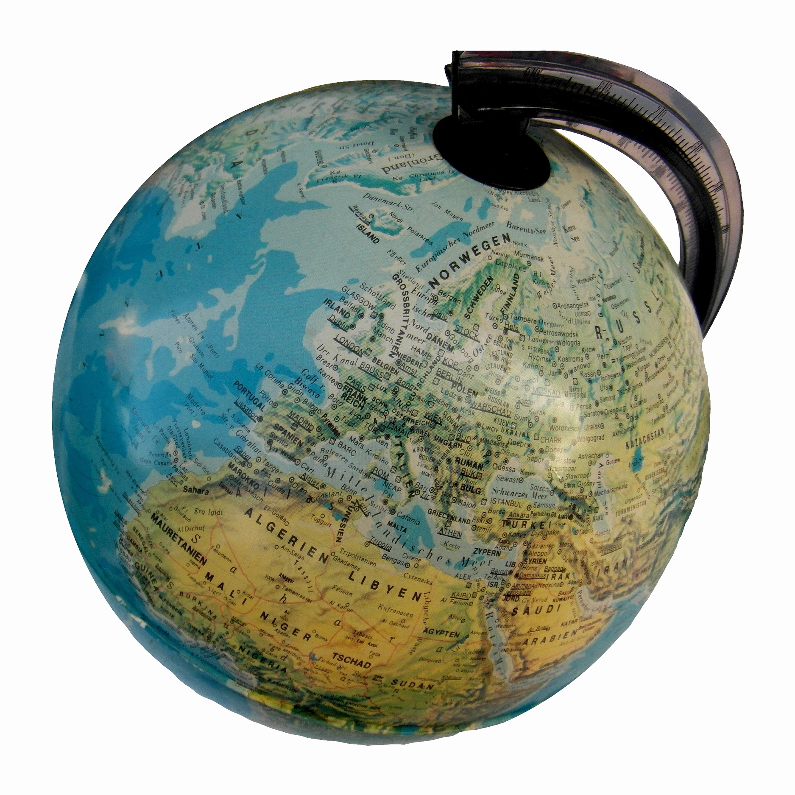
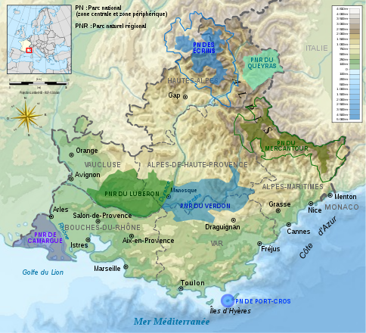
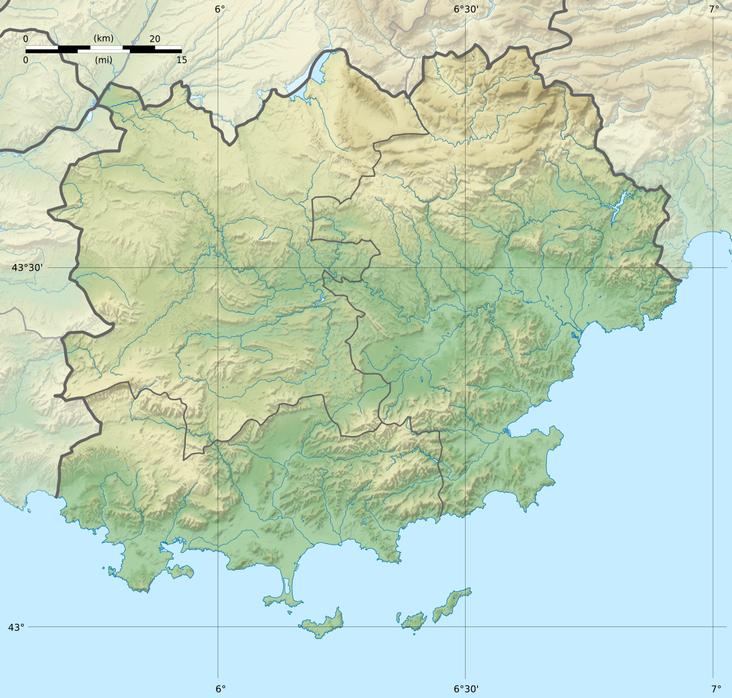
Inhabitants
globale scale
regional scale (provence)
local scale ( Le Pradet)
7.53 billion
10 217
5.059 million

Slide 13
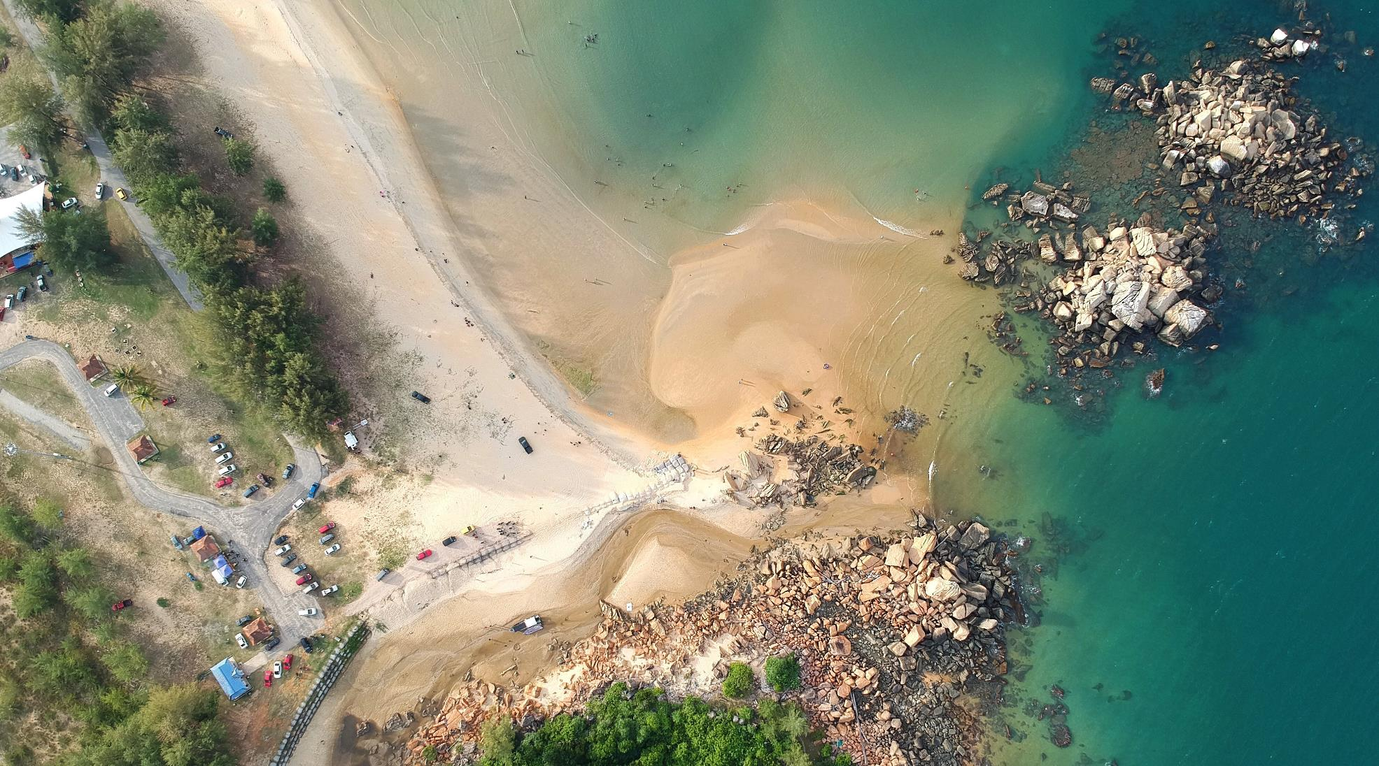
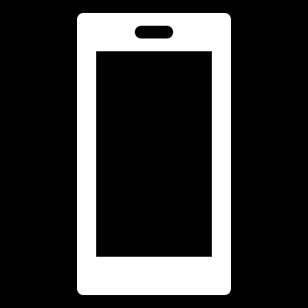
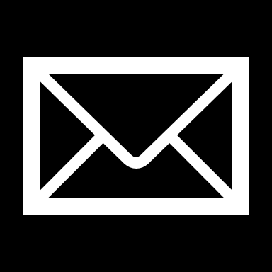
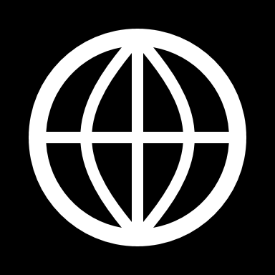

Slide 14
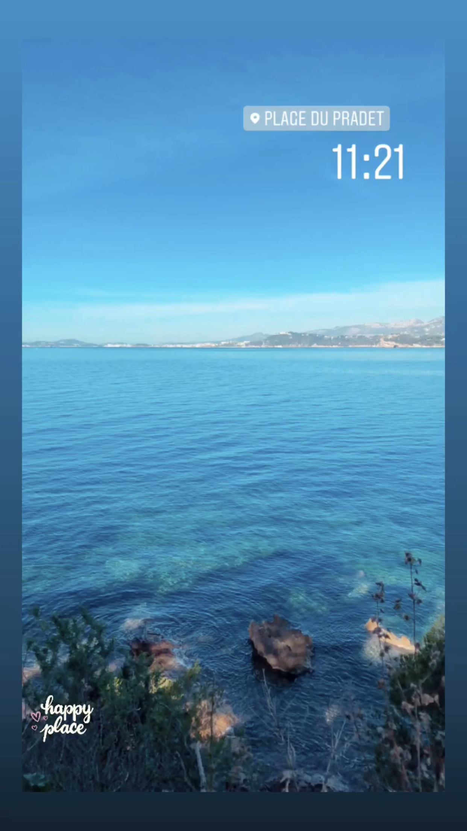
Le Pradet
BAILLOUX Sarah - COLINOT Marie - GHOUAIEL Roselène

Slide 15
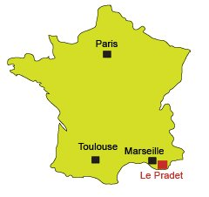
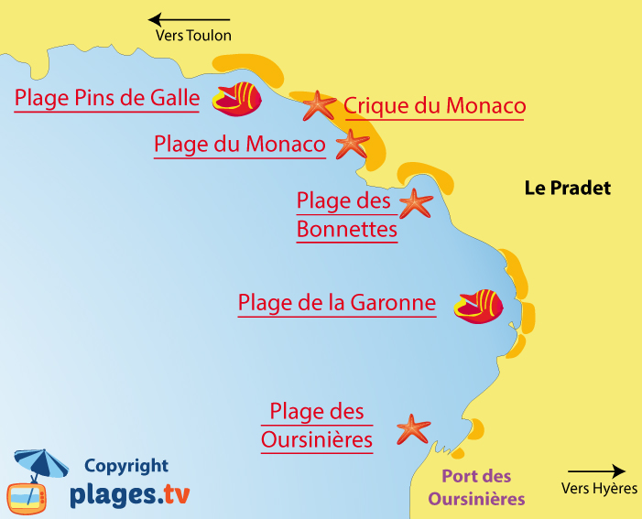
Localisation :
Location of the Pradet
Pradet’s beaches

Slide 16
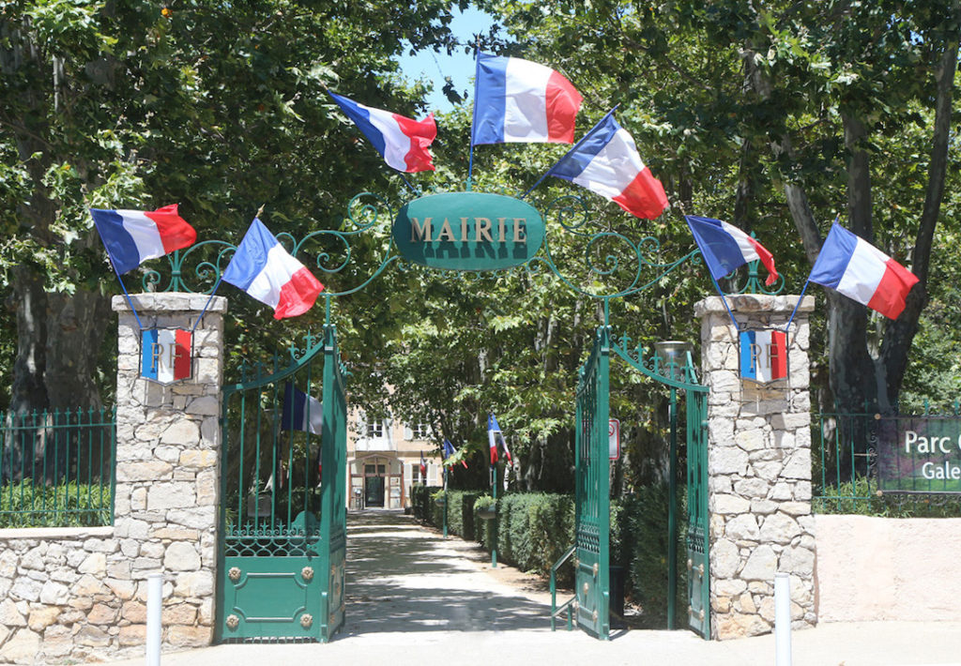
A little bit of history

Slide 17
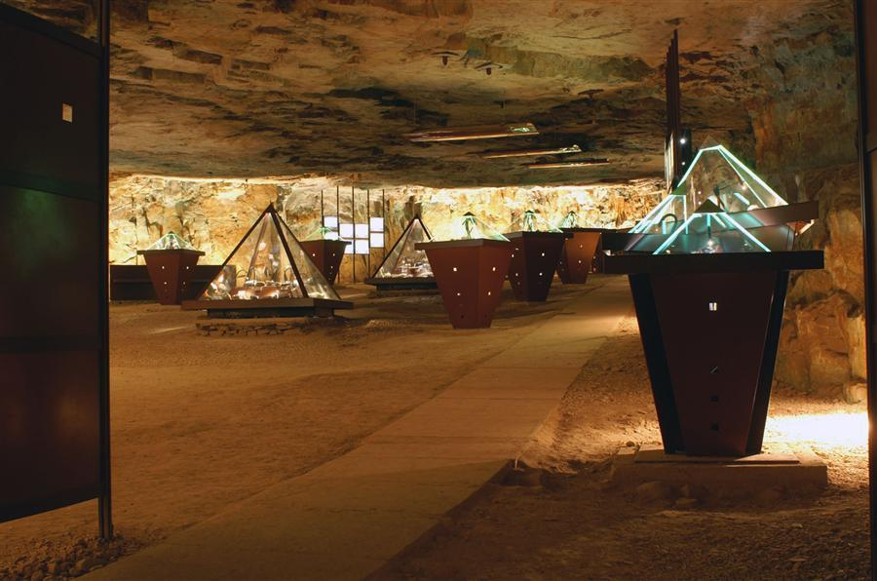
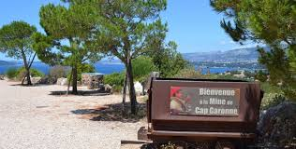
Cap Garonne mine

Slide 18
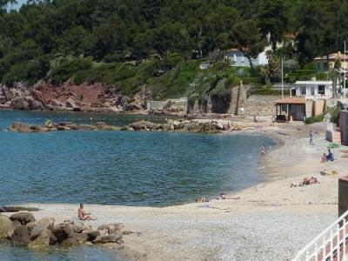
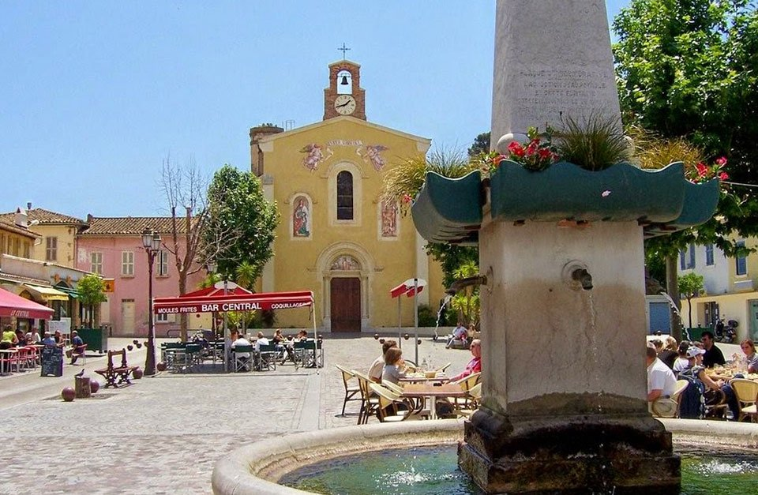
Touristic place:
Garonne beach
The Center

Slide 19
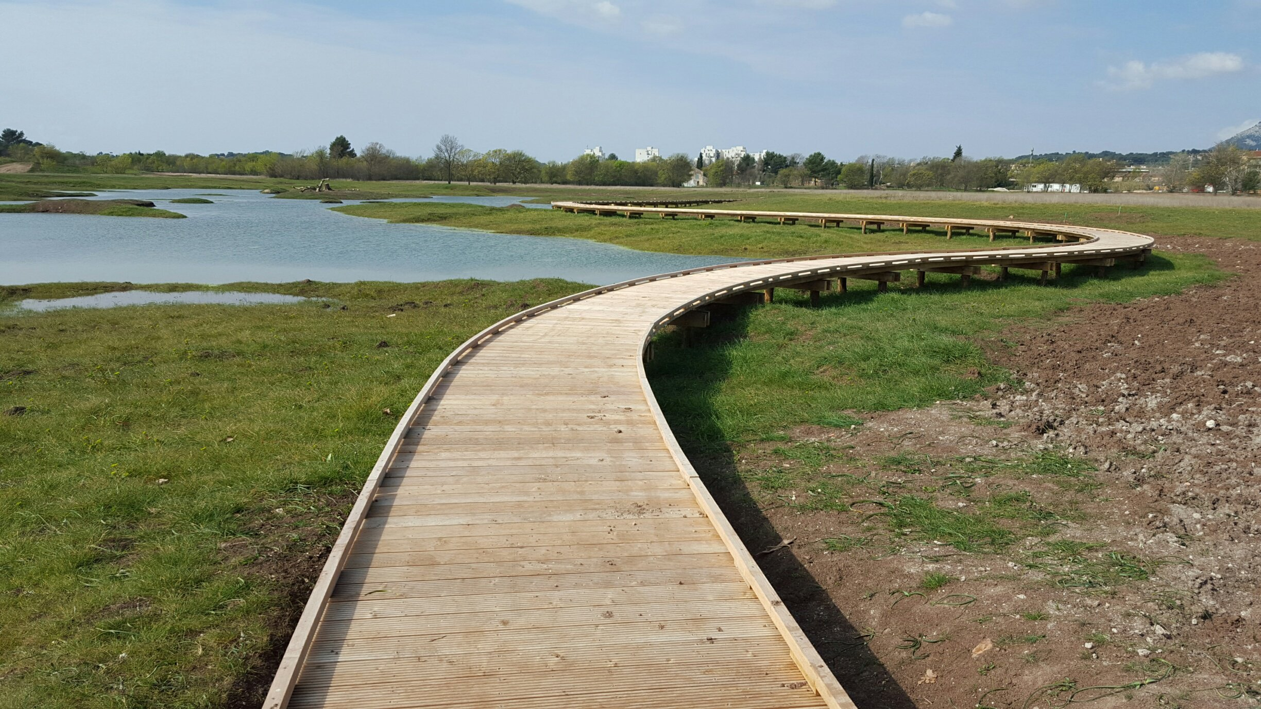
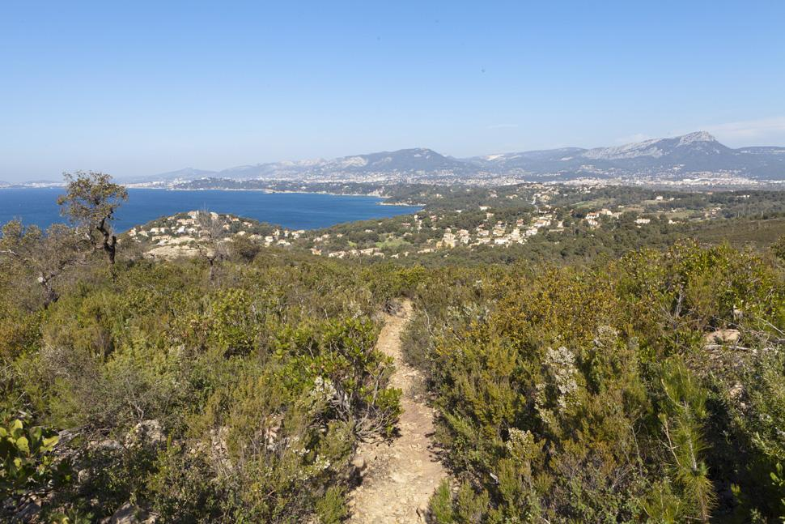
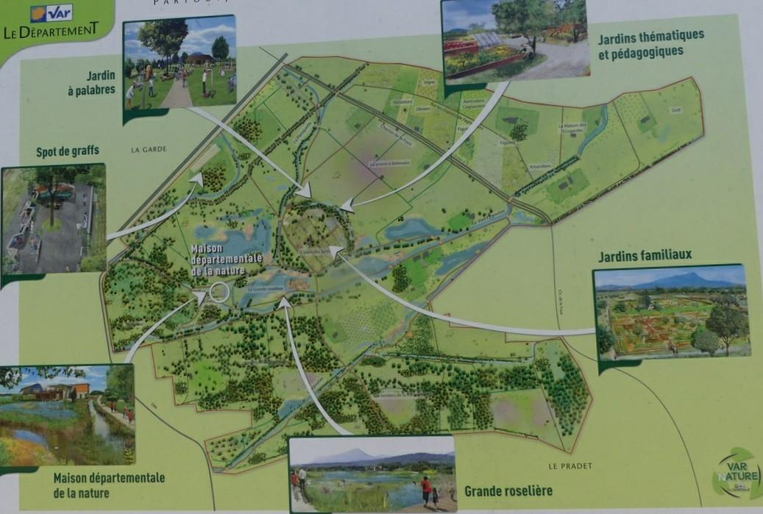
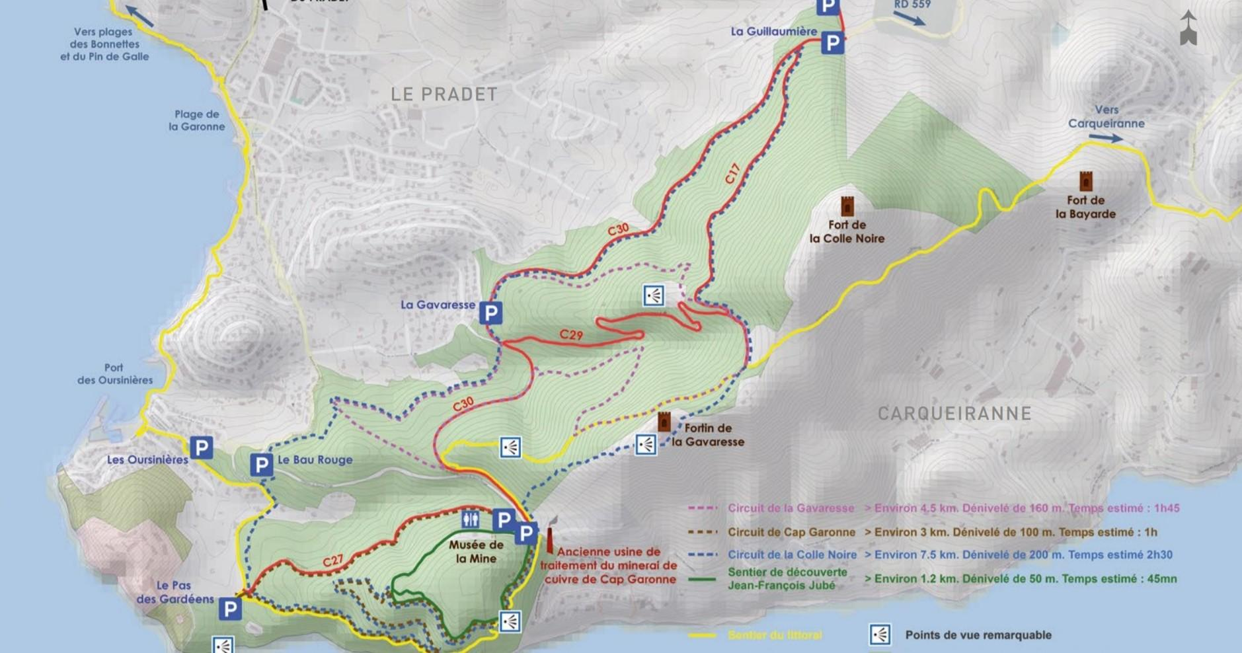
Natural place :
Natural Park ( la Garde - le
Pradet )
Massif of the Colle Noire

Slide 20
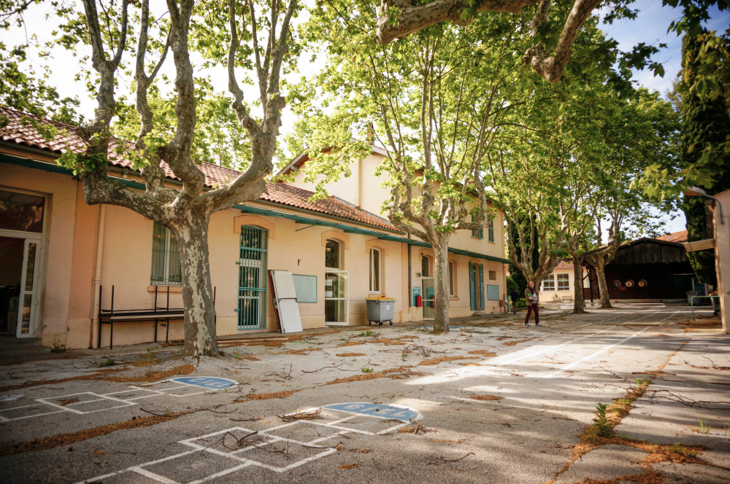
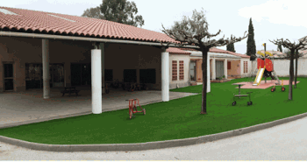
Family place :
Jean Jaurès School (closed) Charles Sandro School

Slide 21
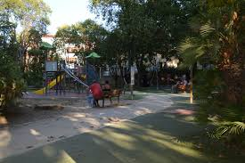
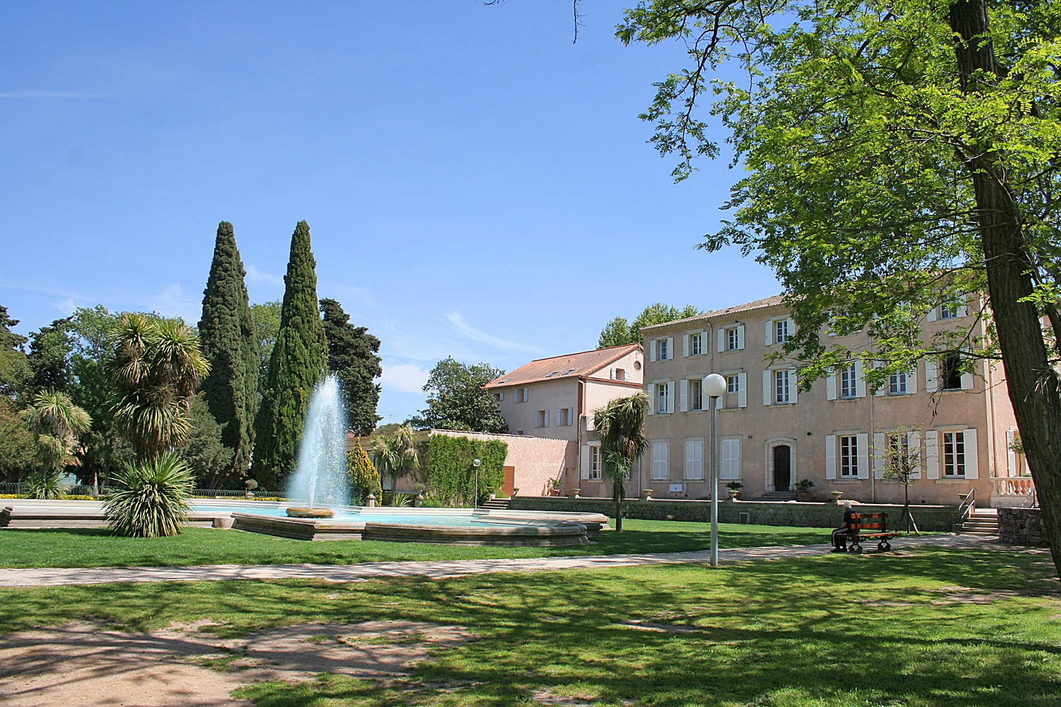
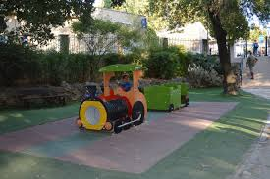
The Cravero park

Slide 22

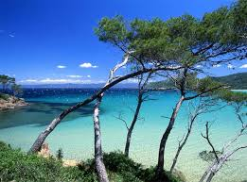
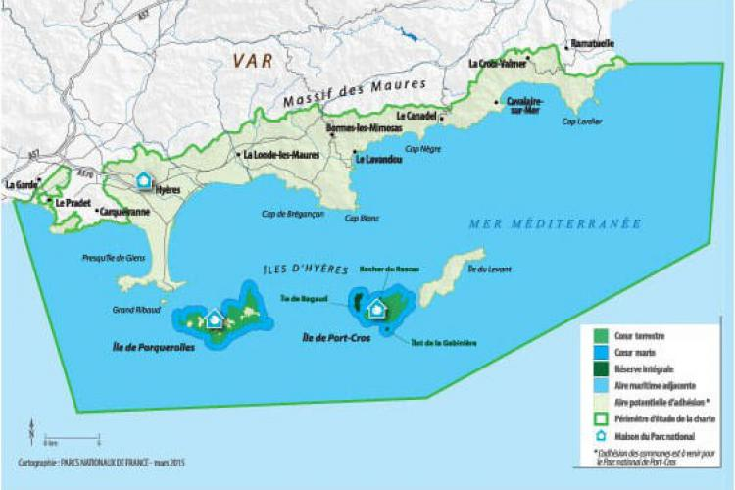
The national park of Port-Cros

Slide 23
Vocabulary :
station balnéaire : seaside resort
mine de cuivre cathode : copper mine
wetlands : zones humides

Slide 24
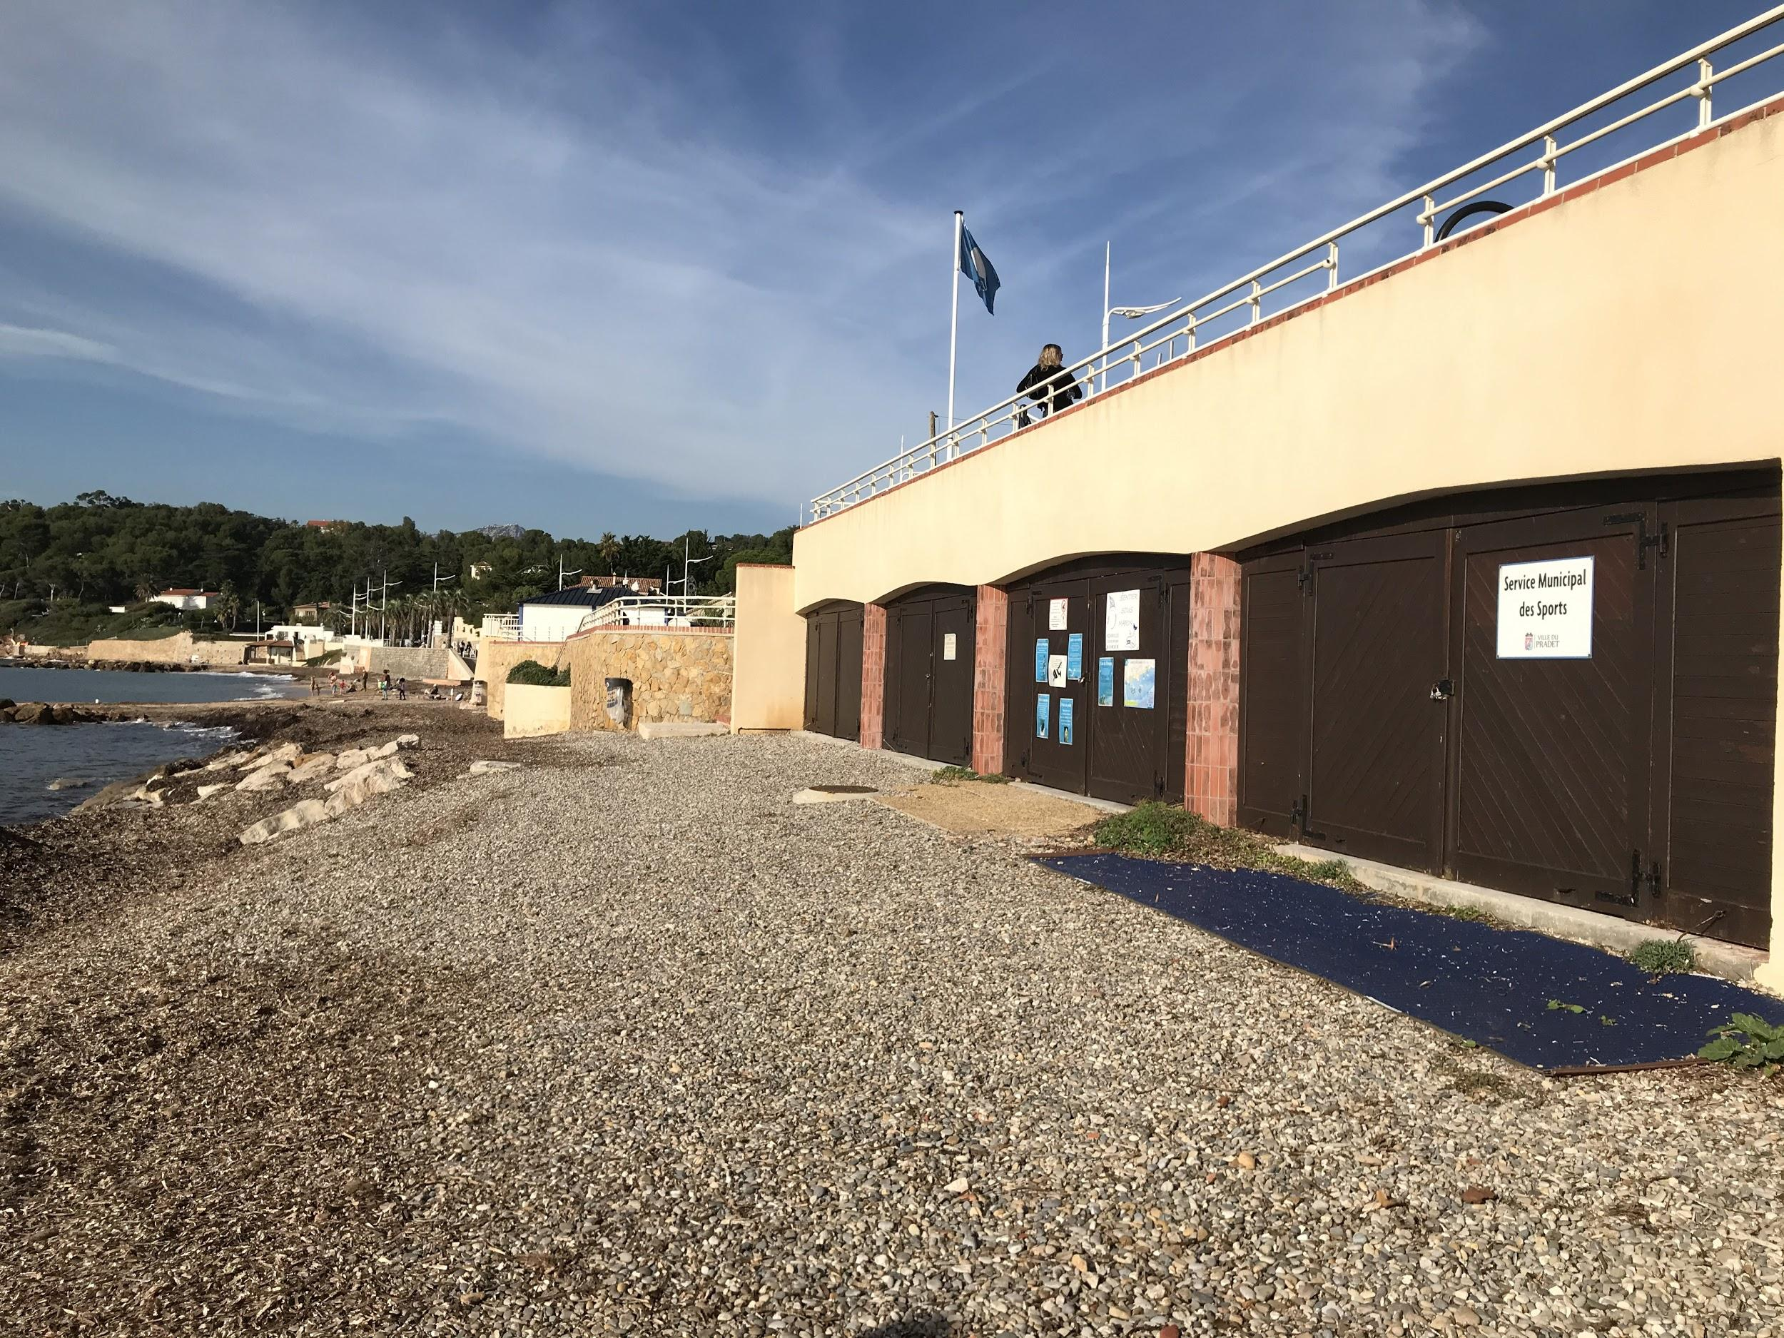

Diving in Le Pradet

Slide 25
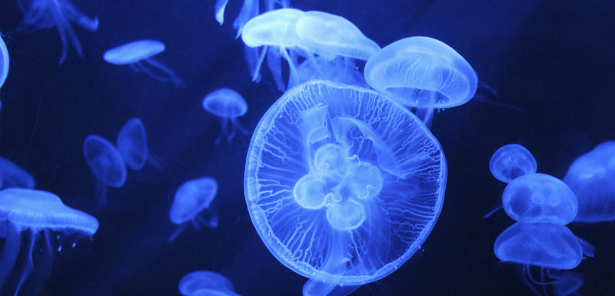
Instructions :
-Do not beat your legs violently to avoid making the fish flee
-Spit in the mask to prevent fogging
-Blow through the nose to remove the water in the mask and unzip
-Watch out for jellyfish
-Rinse all equipment before changing

Slide 26
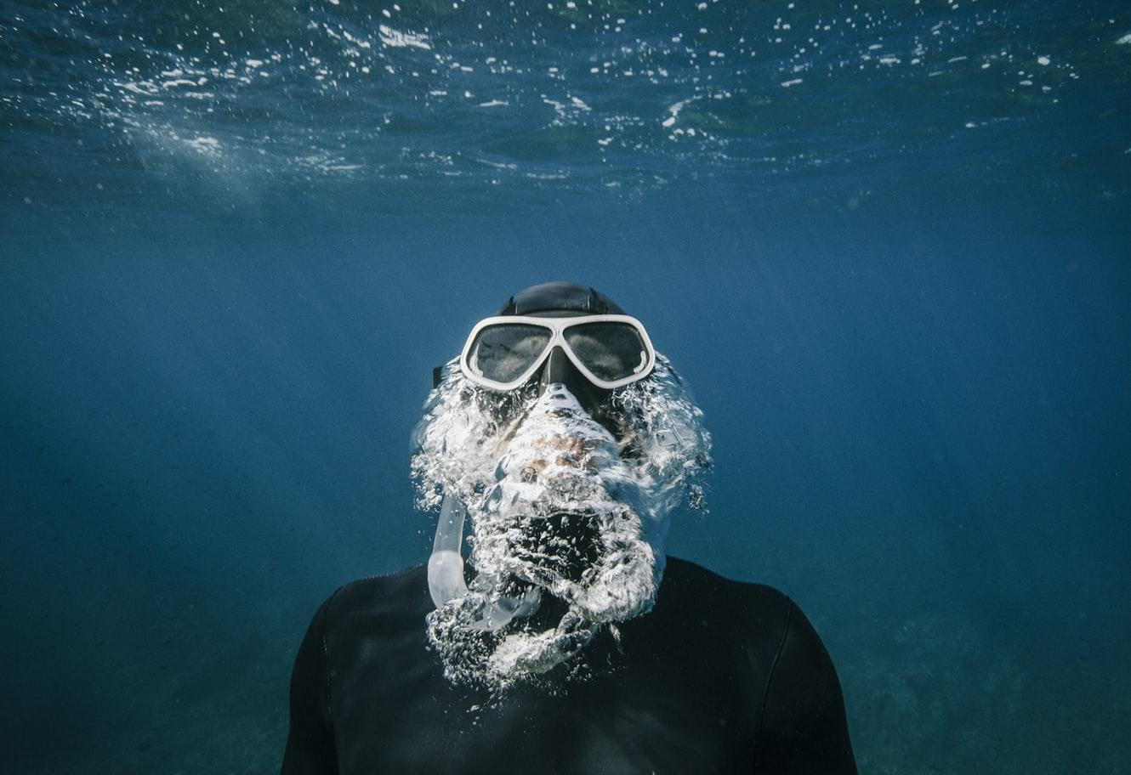
Equipment :
wet suit
goggles
fins
buoy
a snorkel

Slide 27
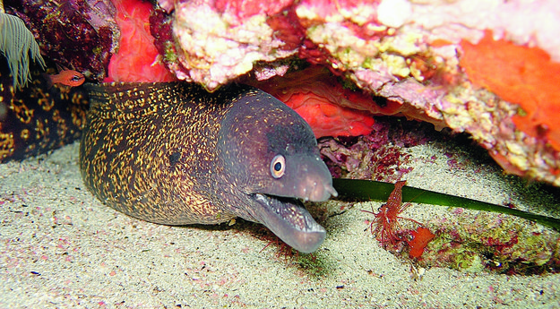
Getting ready to dive :
-Put the west suit on
- Take the goggles and fins
-Go to the beach
-Spit in the mask and rinse it
-Sit down and put the palms on

Slide 28
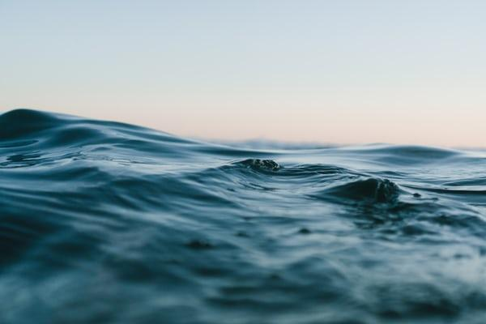
Interviews :
“I was hungry”
Léni
“Without the water, we can’t live : so we don’t have to fear the water”
“The wetsuit was as tight as a sausage”
Léni
Lalie
“Without water, we can’t live : so we don’t have to fear the water”
“I was afraid that the water might be cold”
“I’m afraid of walking on an urchin and to hurt my feet”
Audren
Léni
Lalie

Slide 29
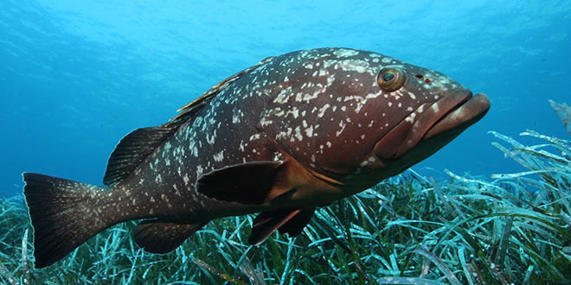
Translation and important words :
buoy : bouée
goggles : masque
fins : palmes
wetsuit : combinaison de plongée
a snorkel : un tuba
to spit : cracher
sore foot : mal au pied
a few : certains, quelques un
the testimonials : les témoignages

Slide 30
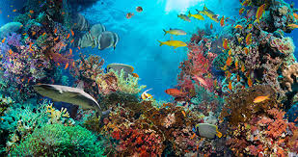
Observation of marine fauna and flora :
VENABLES Zoé
PILHAN Audren
CHAMBON Ornella

Slide 31

Summary :
1- Presentation
2- About the sea
3- About the fauna
4- About the flora

Slide 32
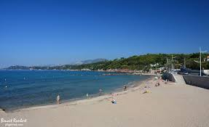
Presentation

Slide 33

The sea
-water rather clear
-seaweed and shells, sand and rock
-the depth : 3 to 5 meters
-the area : around 150 meters

Slide 34
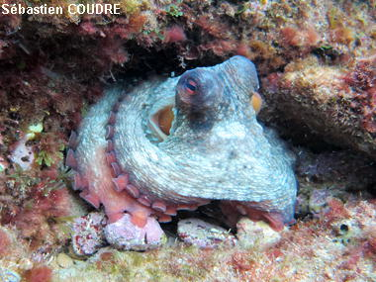
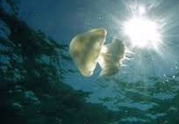
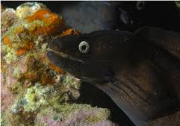





The fauna
Octopus
Jellyfish
Moray
Starfish
Sea cucumber
Sea urchin
Salema
Peacock wrasse

Slide 35




The flora
posidonia : the lung of the sea
peacock alga
cystoseira
ball codium

Slide 36
Impressions afterwards ?
Difficulties ?

Slide 37

Summary
1) People’s impressions
2) survey
3) vocabulary

Slide 38

Q1. Have you ever done scuba diving before ?
Most of the class had done scuba diving before this school trip.

Slide 39

Q2. Did you like it ? Why ?
People liked the scuba diving teachers because they were cool.
People can get to know each other and make friends .
We discovered a lot of new things like fish, star fish, and octopus.

Slide 40

Q3 Would you want to do it again ?
Most of the class wants to do scuba diving again because it was really funny !

Slide 41


Q4 What was your favorite part ?
For a part of the class it was the scuba diving but others really liked the trash part.

Slide 42




Q5 Did you have difficulties ?
the fins
diving was difficult
the water was cold
it was hard to breathe with a snorkel
it’s very cold

Slide 43

Survey
Do you agree ?

Slide 44



Vocabulary
fins : palmes
snorkel : tuba
survey : sondage

Slide 45

Waste Collection
Martin Zoé, Neves Manon, Escudero Lola

Slide 46


Presentation :
The Garonne beach is located in Le Pradet.
The Garonne beach is unfortunately polluted by humans.

Slide 47


Our Job :
Gloves and garbage bags had been put at our disposition.

Slide 48

And after that we started collecting waste :

Slide 49


Cigarette stubs :

Slide 50

Plastic bottles:

Slide 51


Iron pieces :

Slide 52


Cans:

Slide 53


Tissues :

Slide 54
VOCABULARY :
WASTE : Déchets
PICK UP : Ramasser
GARBAGE BAGS : sacs poubelles
CANS : Canettes
CIGARETTE STUB : Mégot de cigarette

Slide 55
Zero Waste LunchBox
Ocean initiatives

Slide 56


What was the project ?
The project was to make a lunchbox that respected the environment.
With the “euro anglais” class, miss Lazare asked us to make a video in which we explained how we packed our zero waste lunchbox.

Slide 57

2) How did we do ?
It seemed hard to do it at first but when you think about it there are so many solutions to replace plastic or individually wrapped items.
Let’s give you some exemples.

Slide 58



3) Ideas for a zero waste lunch box
Instead of putting your sandwich into aluminium paper. You can put it in a reusable plastic box.
Salad in a mason jar

Slide 59






Washable cloth napkin.
Reusable cutlery.

Slide 60








A flask
Bamboo straw

Slide 61



Slide 62


Unfortunately, it’s not always possible not to have any waste because we live in a world where almost everything is wrapped. So, it’s important to recycle what we can.
For example when we picked up the waste on the beach we used garbage bags.

Slide 63

Vocabulary
- Washable cloth napkin = serviette en tissu lavable
- Reusable cutlery = couverts réutilisable
- Bamboo straw = pailles en bambou
- Reusable plastic box = boîte en plastique réutilisable
- Mason jar = Bocaux
-

